Slide 1



Members’ Day
25 June 2025
Uniting, inspiring and collaborating across libraries, information services and cultural organisations in the SouthWest.
www.linkedin.com/in/swrls
@swrls.bsky.social

Slide 2
agenda
11:00-11:10 Chair’s introduction & ACE update
11:10-12:40 panel talks & discussion
12:40-13:30 lunch
13:30-15:00 bibliotherapy session & discussion

Slide 3
Call out for new Trustee:
Skills sought especially in knowledge of charity governance, e.g. policies and law
  Please be in touch if interested in coming on board; we’d be happy to discuss the role…

Slide 4
SWRLS’s activities 2024-2025
- some highlights:
Training:
  Topics include neurodiversity, leadership, handling difficult situations, LGBTQ+, AI (2024-5)
  New resources area on Basecamp, e.g. bid writing
  Careers Forum additions, with thanks to Brett Moodie & Darren Bevin
  Next up: frontline training recordings (via Basecamp), (mis)information, more leadership
Funded projects:
  HEaL (Hospital Engagement & Libraries) - Somerset libraries working with NHS to support health & wellbeing
Notes:
Donna, to mention bid writing (if wanted), bibliotherapy – see how today goes…

Slide 5
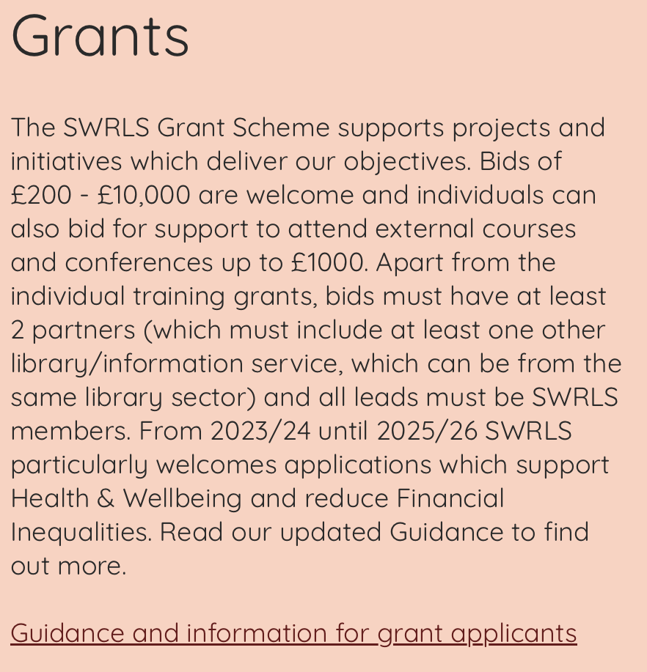
SWRLS grants
Notes:
ACE grants – libraries priority bid – ask Nell O’Hora to say a few words, including about matched funding requirement
SWRLS can offer matched funding

Slide 6
Current ACE Opportunities for Public Libraries
National Lottery Project Grants: Universal Library Offers
Libraries Development Framework

Slide 7
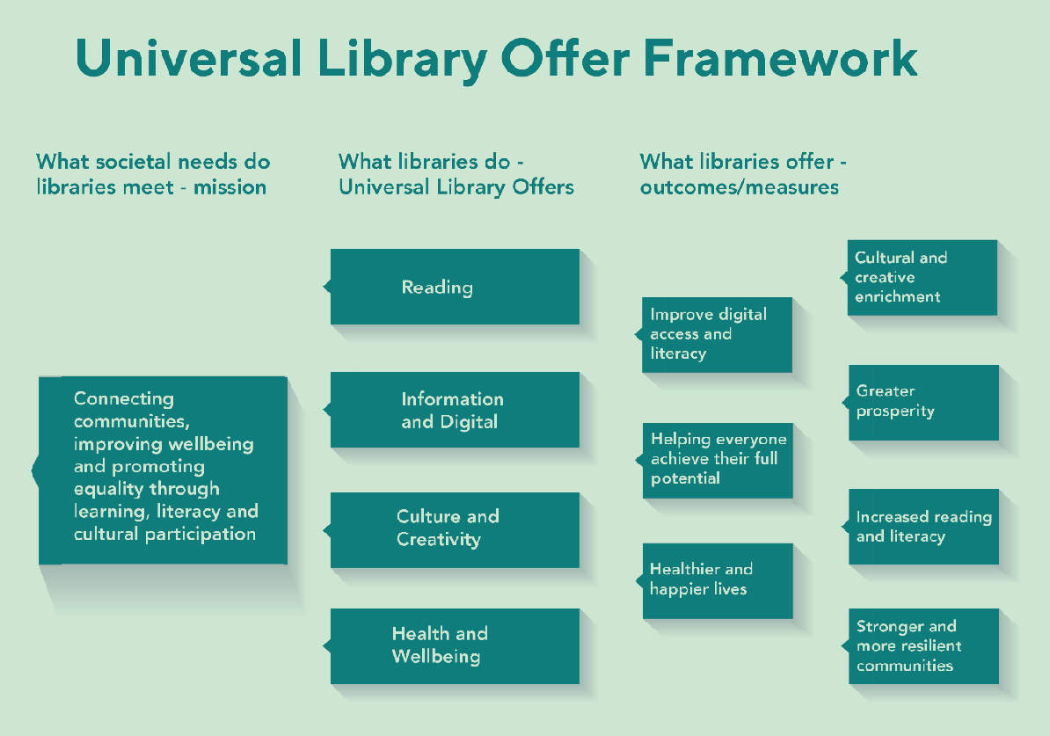
National Lottery Project Grants: ULOs

Slide 8

Project Grants website artscouncil.org.uk/ProjectGrants
How to Apply
Library Projects and the ULOs
Access guidance
Match Funding
Time limited priorities (until November)
Offline questions template (RM)

Slide 9
Libraries Development Framework
What is the Libraries Development Framework?
It is a national framework for library services that ACE administer. The framework supports library services in meeting the needs of their communities and fosters national consistency. As a library service, you can apply to be part of the framework to demonstrate and evidence your commitment to ongoing development, innovation, and best practice.
Registration for the Libraries Development Framework is open on Grantium. The deadline for applications to be submitted is 12pm on Wednesday 23 July. Decisions will be shared on Grantium on Monday 1 December.

Slide 10



Customer Services
enquiries@artscouncil.org.uk
  Relationship Managers
  lynne.taylor@artscouncil.org.uk
  nell.ohora@artscouncil.org.uk
  ACE website
  https://www.artscouncil.org.uk/supporting-arts-museums-and-libraries/supporting-libraries

Slide 11
Panel discussion on Advocacy
Luke Burton
Rebecca Bolton
Tabitha Witherwick
Donna Gundry

Slide 12
agenda
agenda
11:00-11:05 Chair’s introduction
11:05-12:30 panel talks & discussion
12:30-13:30 lunch
13:30-14:50 bibliotherapy session & discussion
14:50-15:00 closing remarks & end
11:00-11:10 Chair’s introduction & ACE update
11:10-12:40 panel talks & discussion
12:40-13:30 lunch
13:30-15:00 bibliotherapy session & discussion

Slide 13
Bibliotherapy
Anna Orchard & colleagues

Slide 14
Thank you for joining us today

